Slide 1
Lecture 5

Slide 2
Policies for Hedging Transaction Exposure
Hedging Most of the Exposure
  Hedging most of the transaction exposure allows MNCs to more accurately forecast future cash flows (in their home currency) so that they can make better decisions.
Selective Hedging
  MNC must identify its degree of transaction exposure.
  MNC must consider the various techniques to hedge the exposure so that it can decide which hedging technique is optimal and whether to hedge its transaction exposure.

Slide 3
Hedging Exposure to Payables
An MNC may decide to hedge part or all of its known payables transactions using:
  Forward / futures hedge
  Money market hedge
  Currency option hedge.

Slide 4
Hedging Exposure to Payables
Forward or Futures Hedge on Payables
Allows an MNC to lock in a specific exchange rate at which it can purchase a currency and hedge payables.
A forward contract is negotiated between the firm and a financial institution. The contract will specify the:
  currency that the firm will pay
  currency that the firm will receive
  amount of currency to be received by the firm
  rate at which the MNC will exchange currencies (called the forward rate)
  future date at which the exchange of currencies will occur.

Slide 5
Hedging Exposure to Payables
Money Market Hedge on Payables
Involves taking a money market position to cover a future payables position
If a firm prefers to hedge payables without using its cash balances, then it must:
  Borrow funds in the home currency and
  Invest in the foreign currency.
Money market hedge versus forward hedge
  Since the results of both hedges are known beforehand, the firm can implement the one that is more feasible

Slide 6
Hedging Exposure to Payables
Call Option Hedge on Payables
A currency call option provides the right to buy a specified amount of a particular currency at a specified strike price or exercise price within a given period of time
The currency call option does not obligate its owner to buy the currency at that price.
The MNC has the flexibility to let the option expire and obtain the currency at the existing spot rate when payables are due

Slide 7
Hedging Exposure to Payables
Call Option Hedge on Payables (cont.)
Cost of call options based on contingency graph
  Advantage: provides an effective hedge
  Disadvantage: premium must be paid
Cost of call options based on currency forecasts
  MNC can incorporate forecasts of the spot rate to more accurately estimate the cost of hedging with call options
Consideration of Alternative Call Options
  Several different types of call options may be available, with different exercise prices and premiums for a given currency and expiration date
  Whatever call option is perceived to be most desirable for hedging a particular payables position would be analysed, so that it could then be compared to the other hedging techniques

Slide 8
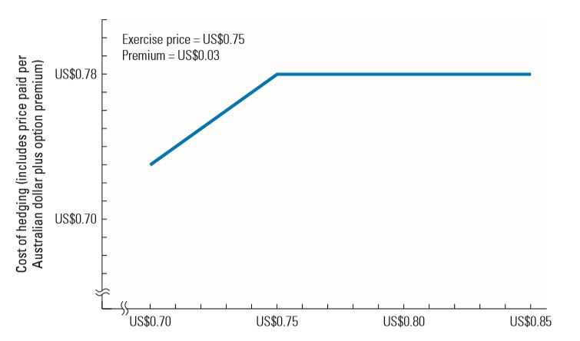
Contingency Graph for Hedging Payables With Call Options

Slide 9
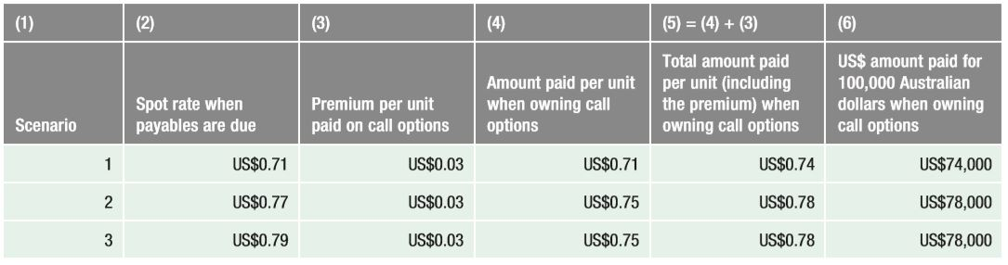
Using Currency Call Options to Hedge Australian dollar Payables (exercise price = us$0.75, premium = us$.03)

Slide 10
Hedging Exposure to Payables
Comparison of Techniques to Hedge Payables
The cost of the forward hedge or money market hedge can be determined with certainty
The currency call option hedge has different outcomes depending on the future spot rate at the time payables are due

Slide 11
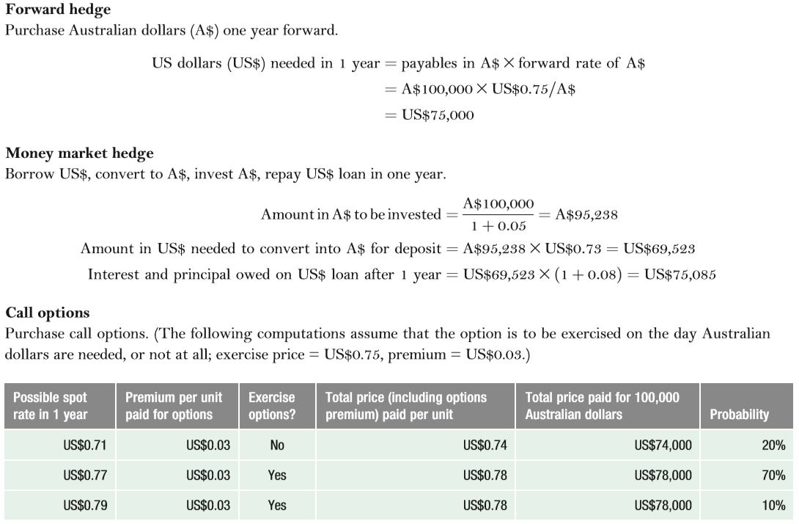
Comparison of Hedging Alternatives for Coleman Co.

Slide 12
Hedging Exposure to Payables
Comparison of Techniques to Hedge Payables
Optimal Technique for Hedging Payables
  Select optimal hedging technique by:
    Consider whether futures or forwards are preferred
    Consider desirability of money market hedge versus futures/forwards based on cost
    Assess the feasibility of a currency call option based on estimated cash outflows
Choose optimal hedge versus no hedge for payables
  Even when an MNC knows what its future payables will be, it may decide not to hedge in some cases
Evaluate the hedge decision by estimating the real cost of hedging versus the cost if not hedged

Slide 13
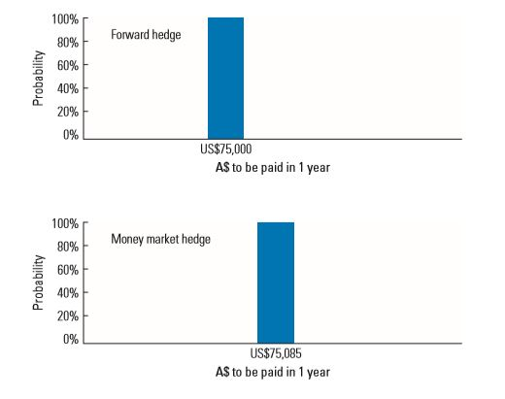
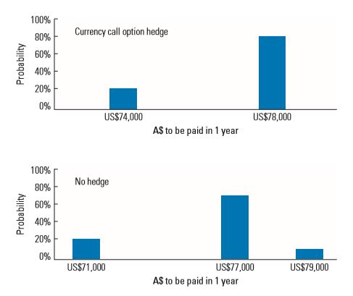
Graphic Comparison of Techniques to Hedge Payables

Slide 14
Hedging Exposure to Receivables
Forward or futures hedge on receivables allows the MNC to lock in the exchange rate at which it can sell a specific currency
Money market hedge on receivables involves borrowing the currency that will be received and using the receivables to pay off the loan

Slide 15
Hedging Exposure to Receivables
Put option hedge on receivables provides the right to sell a specified amount of a particular currency at a specified strike price by a specified expiration date
Cost of Put Options Based on Contingency Graph
  Advantage: provides an effective hedge
  Disadvantage: premium must be paid
Cost of Put Options Based on Currency Forecasts
  MNC can use currency forecasts to more accurately estimate the dollar cash inflows to be received when hedging with put options
Consideration of Alternative Put Options
  Several different types of put options may be available that feature different exercise prices and premiums for a given currency and expiration date

Slide 16
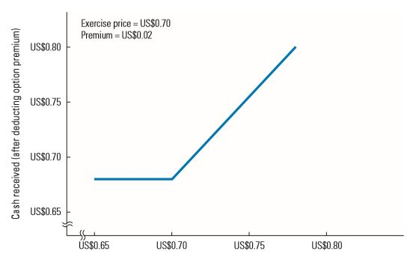
Contingency Graph for Hedging Receivables with Put Options

Slide 17
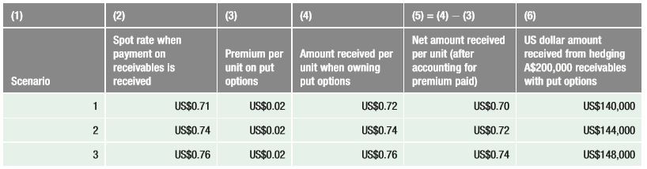
Use of Currency Put Options for Hedging Australian dollar Receivables (exercise price = us$0.72; premium = us$0.02)

Slide 18
Hedging Exposure to Receivables
Comparison of Techniques for Hedging Receivables
Optimal Technique for Hedging Receivables:
  Consider whether futures or forwards are preferred
  Consider desirability of money market hedge versus futures/forwards based on cost
  Assess the feasibility of a currency put option based on estimated cash outflows
Optimal hedge versus no hedge on receivables
  An MNC may know what its future receivables will be yet still decide not to hedge.
  In that case, the MNC needs to determine the probability distribution of its revenue from receivables when not hedging

Slide 19
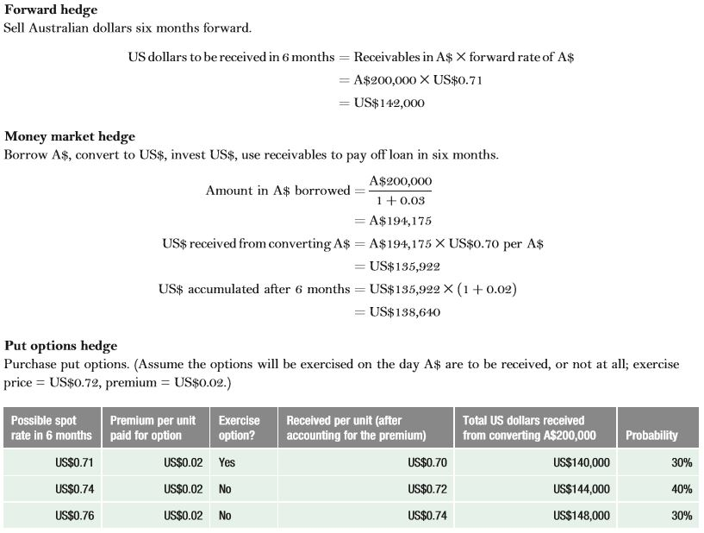
Comparison of Hedging Alternatives for Viner Co.

Slide 20
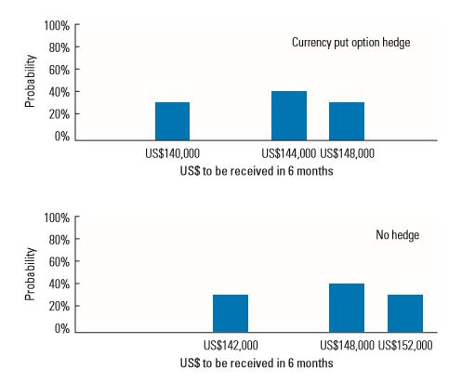
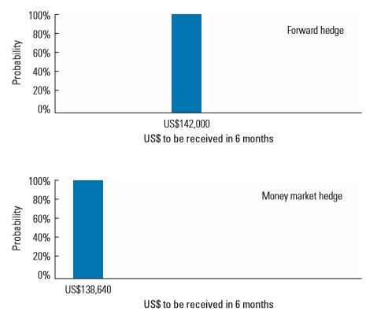
Graph Comparison of Techniques to Hedge Receivables

Slide 21
Hedging Exposure to Receivables
Evaluating the hedge decision by estimating the real cost of hedging receivables versus the cost of receivables if not hedged
Summary of Hedging Techniques each of the hedging techniques is briefly summarised in Exhibit 12.9

Slide 22
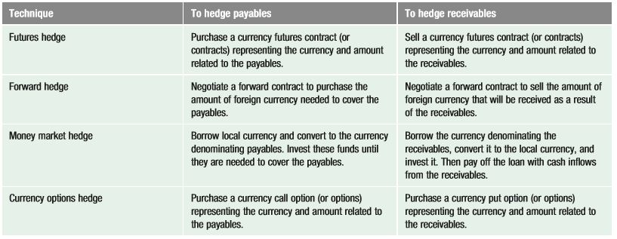
Review of Techniques for Hedging Transaction Exposure

Slide 23
Limitations of Hedging
Limitation of Hedging an Uncertain Payment
  Some international transactions involve an uncertain amount of foreign currency, leading to over-hedging.
Limitation of Repeated Short-Term Hedging
  The continual short-term hedging of repeated transactions may have limited effectiveness.
  Long-term Hedging as a Solution
    Some banks offer forward contracts for up to 5 years or 10 years on some commonly traded currencies

Slide 24
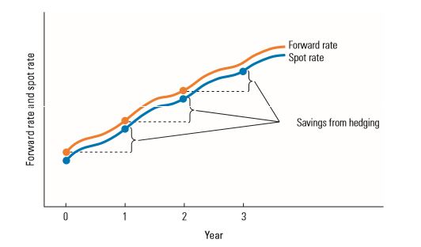
Repeated Hedging of Foreign Payables When the Foreign Currency Is Appreciating

Slide 25
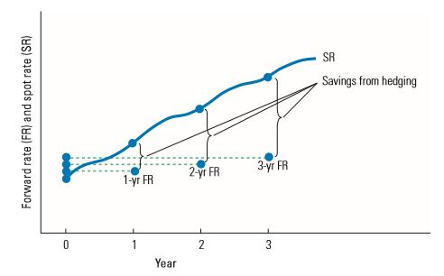
Long-Term Hedging of Payables When the Foreign Currency Is Appreciating

Slide 26
Alternative Hedging Techniques
Leading and Lagging: adjusting the timing of a payment or disbursement to reflect expectations about future currency movements
Cross-Hedging: hedging by using a currency that serves as a proxy for the currency in which the MNC is exposed
Currency Diversification: reduce exposure by diversifying business among numerous countries

